Slide 1
Mathematical APPROCHES TO MACHINE TRANSLATION
By Rhys Nicholas

Slide 2
Machine Translation
Machine Translation is the field dedicated to translating by the process of machines and computers.
Cath
Cat
Computer
Language B / Target Language
Language A /
Source Language
English
Welsh
SYSTRAN (1996)
Babelfish (1997)
Google Translate (2006)

Slide 3
Machine Translation
Fully Automatic
Medical
Weather Reports
Scientific Journals
Legal Documents
High Quality
Machine Translation
Restricted Translation
e.g Medical
Neural Network
Human Translation
e.g Google Translate
Unrestricted Texts

Slide 4
Types of Machine Translation
Machine translation can be broken down into a short generalised list:
Rule based MT
Rules for TL
Statistical Translation
Target Language
Source Language
Rules for SL
Source Language
Statistical MT
Target Language
Bayes Theorem for n-gram Words or Sentences
Statistical methods for proofing and errors
Dictionary
Grammatical
Word order
Tense
Structure
etc

Slide 5
Types of Machine Translation
Machine translation can be broken down into a short generalised list:
Rule based MT
Statistical Translation
Target Language 1
Source Language
Statistical Translation
Rules for TL
Target Language
Statistical MT
Source Language
Target Language
Hybrid Models
Rules for
TL & SL
Target Language 2
Source Language
Rules for TL
Statistical Translation
Target Language

Slide 6
Types of Machine Translation
Machine translation can be broken down into a short generalised list:
Rule based MT
Source Language
Neural Network Engine
Target Language
Statistical MT
Hybrid Models
Neural Networks
Pre-trained engine for SL & TL
Trained on end-end pairs SL/TL pairs of texts
Often uses statistical methods in the engine for determining success

Slide 7
Dictionary Translation
Rule based MT
Source Language
For each word in SL:
Replace with corresponding word in TL
Target Language
Rules for SL
Rules for TL
Assumptions
Constraints
Assumes translation is 1-1
Basic English
Assumes TL shares grammar with SL

Slide 8
Basic English
Basic English is linguistically designed subset of English using a restricted word pool. Intended to be a simplified form of English.
Originally made in 1925
850 Words
Simplified Grammar

Slide 9
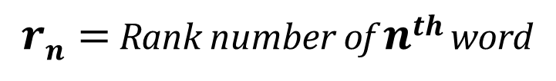

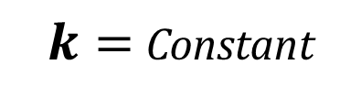

Basic English
- Zipfs
Zipfs is an Empirical (observed) law that applied to the linguistic frequency of language gives a relationship between the frequency of any word in a language rank.
$rn∝\frac{1}{fn}⇒rn$ =$\frac{k}{fn}$
“ The frequency of a word in a language is inversely proportional to it’s rank”
$rn=$ Rank number of $nth$word
$fn=$ Frequency of $nth$word
$k=$ Constant

Slide 10
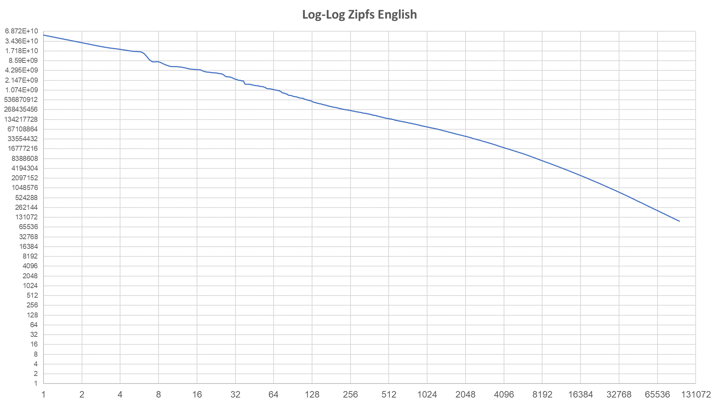

Slide 12
Dictionary Translation
Rule based MT
For each word in SL:
Replace with corresponding word in TL
Target Language
Source Language
Rules for SL
Rules for TL
Assumptions
Constraints
Assumes translation is 1-1
Basic English
Requires pre-translated words (dictionary of SL to TL)
Assumes TL shares grammar with SL

Slide 13
Dictionary Translation - Results
Python
Sentence Translator
For each word in SL:
Replace with corresponding word in TL
Target Language
Source Language
Paragraph Translator
“ The cat on the floor”
“Y cath ar y llawr”
“The sun did not shine. It was too wet to play. So we sat in the house all that cold, cold wet day.”
“Y haul did nid shine. It was too gwlyb i chwarae. Felly we sat yn y tŷ i gyd bod cold, cold, gwlyb diwnord”
“Put it on the shelf”
“Rhoi it ar y silff”

Slide 14
Dictionary Translation - Results
In terms of Simplification
In terms of Translation
Simple inputs yield translation
Grammar is incorrect
Complex input yield partial translations
No tense
Wrong Structures
Results are “legible” and comprehensible to bilingual readers.
Meaning isn’t necessarily preserved
Simple words are not translated

Slide 15
Dictionary Translation - Results
Improvements
Widen Constraints (BE 1000 Words)
Grammar:
Word order
VSO (Verb Subject Object)
Structure
SVO (Subject Verb Object)
Punctuation

Slide 16
Cryptographic Approaches
Cryptology
Translation
Cryptographic Codes & Codebooks
Translation is a form decryption from one language to another
Encrypt texts of words, sentences or phrases
Look up reference tables are used, originally in the form of books

Slide 17
Cryptographic Approaches
Cryptographic Translation
Encryption can be seen as a mapping of plaintext to encrypted text. This is similar to translating from source language to target language.
Cat
Cath
Dog
Ci
House
Tŷ
Door
Drws
1-1 Mapping

Slide 18
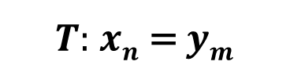
Cryptographic Approaches
Cryptographic Translation
$$x=Source Language=x1,x2, …xn$$
$$y=Target Language=y1,y2, …ym$$
$$T:SL⟶TL$$
$$y=T(x)$$
Dictionary Translation
$y=T\left(x\right)=T\left(x1\right),T(x2)$,…, $T(xn)$
$T:$ $xn$ = $ym$

Slide 19








Further Applications & Models
Models
$$a11………a1n$$
Apply Grammatical Models
$$T:SL⟶TL$$
$$.$$
$$⟹$$
$$A=$$
$$y=Ax$$
$$.$$
$$y=T(x)$$
$$.$$
Word Matrices
$$am1………amn$$

Slide 20
Further Applications & Models
Models
Research
Goals
Apply Grammatical Models
Lexical Similarity
Produce more complex translation models
Word Matrices
“Closeness of languages”
Apply Statistical Methods for proofing
Translate text from “Cat in the hat”
RMSE

Slide 21
Questions?
References
Machine Translation - Warren Weaver Memorandum - Rockefeller Foundation:
http://www.mt-archive.info/Weaver-1949.pdf
The history of machine translation in a nutshell - John Hutchins:
http://hutchinsweb.me.uk/Nutshell-2005.pdf
Ten years of Google Translate - Barak Turovsky:
blog.google/products/translate/ten-years-of-google-translate
A Simple Model Outlining Translation Technology:
https://archive.is/20120716095630/http://tandibusiness.blogspot.de/2006/02/simple-model-outlining-translation.html#selection-179.0-179.47

Slide 22
Questions?
References
Different types of Machine Translation:
https://localizeblog.com/types-of-machine-translation/
Proceedings ICWIT 2012 160 Theoretical Overview of Machine translation:
http://citeseerx.ist.psu.edu/viewdoc/download?doi=10.1.1.416.1463&rep=rep1&type=pdf#page=176

Slide 23
Questions?
References
Basic English - Charles K Ogden:
http://ogden.basic-english.org/be0.html
Ronald E. Wyllys - Empirical and Theoretical Bases of Zipf’s Law:
https://www.ideals.illinois.edu/bitstream/handle/2142/7182/librarytrendsv30i1g\_opt.pdf

Slide 24
Questions?
References
A History of U.S. Communications Security (Volumes I and II):
https://www.governmentattic.org/18docs/Hist_US_COMSEC_Boak_NSA_1973u.pdf
Exploiting Similarities among Languages for Machine Translation:
https://arxiv.org/pdf/1309.4168.pdf
Efficient Estimation of Word Representations in Vector Space:
https://arxiv.org/pdf/1301.3781.pdf

Slide 25
Questions?
References
_{Business Dynamics:}
Systems Thinking and Modelling for a Complex World:
Textbook – Errata Contains RMSE equation
_{Cat in the Hat - Dr Seuss:}
https://www.oatridge.co.uk/poems/d/dr-seuss-cat-in-the-hat.php

